Slide 1
Crimes and accidents in toronto
Tigran
Sue
Dian
Dalia

Slide 2
Why Crime and Accidents(ksi)?
Helps effectively reduce crime in a city.
Helps decision making to implement data driven strategies like hotspot policing, problem oriented policing, and intelligence-led policing etc.
Helps us understand the relationship between different various criminogenic factors or major crime indicators.
Motor vehicle accidents remain a leading cause of death for young people in Canada.
Helps identifying accident hot spots and thus in effective road safety planning.
Helps identifying the root cause so as to have preventative measures for future strategic planning.

Slide 3
Questions
What are the most common types of crime in toronto?
Which neighborhoods experience the highest crime rates?
How do crime rates fluctuate over time?
How does the income level in a neighborhood affect crime rates?
How does the education level in a neighborhood affect crime rates?
Which areas are most prone to traffic accidents?
How did the number of traffic accidents change over time?

Slide 4
DATA Souces
TORONTO POLICE APIS
MCI - MAJOR CRIME INDICATORS
ARGUMENTS FOR MONTH AND YEAR TO GET AROUND 2000-RECORD LIMIT
KSI - TRAFFIC INCIDENTS
Homicide data API, Toronto Police
STATS CANADA CENSUS API
ARGUMENTS FOR GEOCODE AND TOPIC
MAPBOX API
ADDITIONAL DATASETS
NEIGHBORHOODS-TRACTS CONVERSION CSV

Slide 5
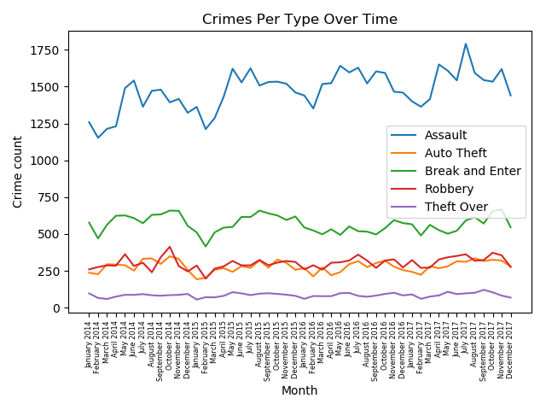
MOST COMMON CRIME TYPES

Slide 6
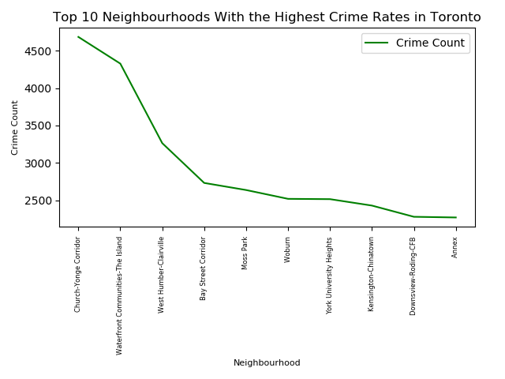
Top 10 Neighbourhoods With the Highest Crime Rates in Toronto

Slide 7
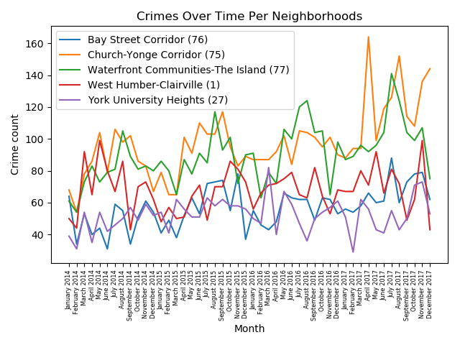
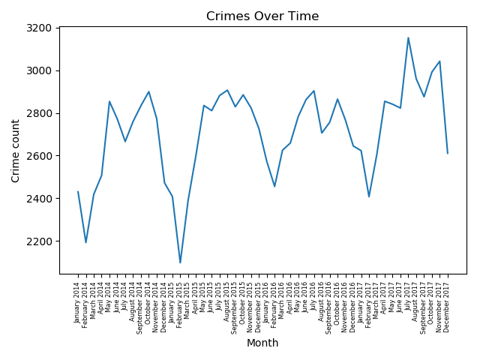
CRIMES OVER TIME

Slide 8
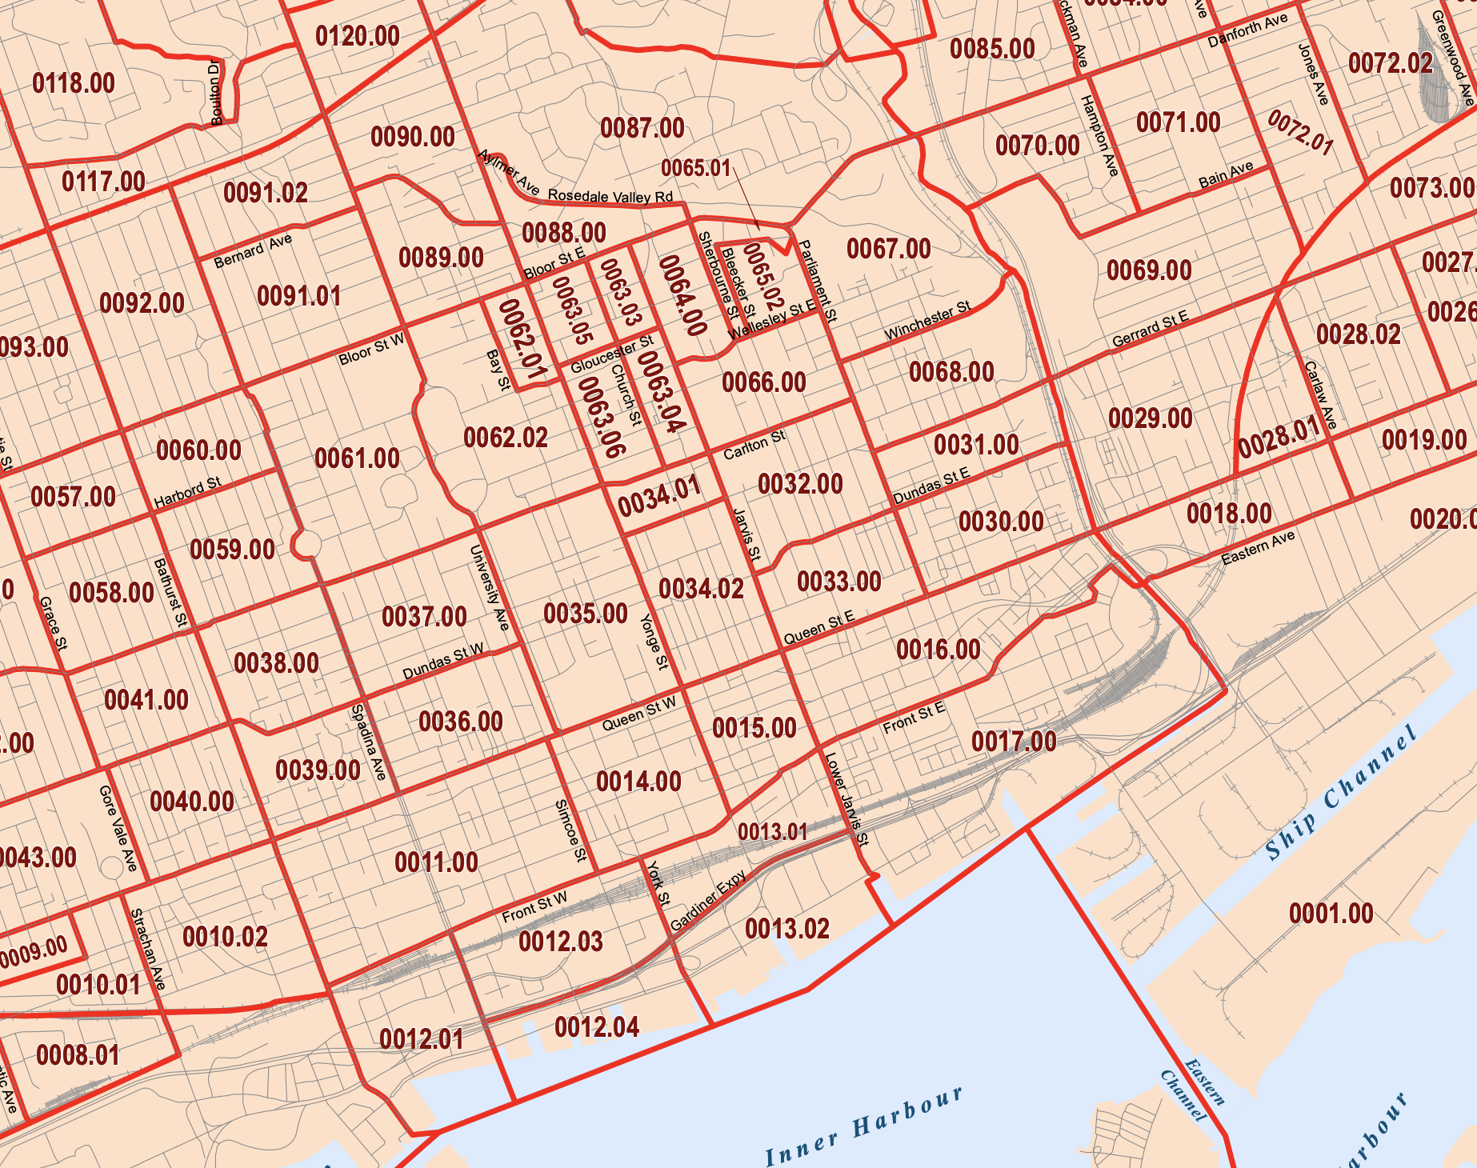
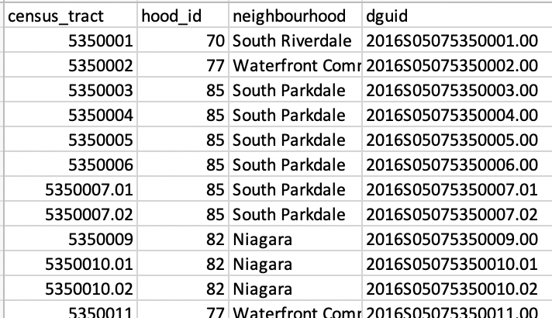
CRIMES VS INCOME and education
POLICE API
ALL INCIDENTS
W/ NEIGHBORHOOD ID
CENSUS API
PULL DATA PER GEOCODE (CENSUS TRACT)
?
https://www12.statcan.gc.ca/rest/census-recensement/ CPR2016.json?lang=E&dguid={dguid}&topic=7

Slide 9
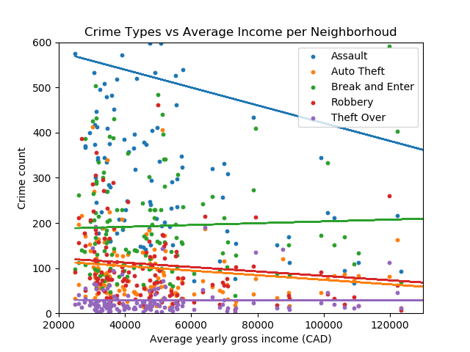
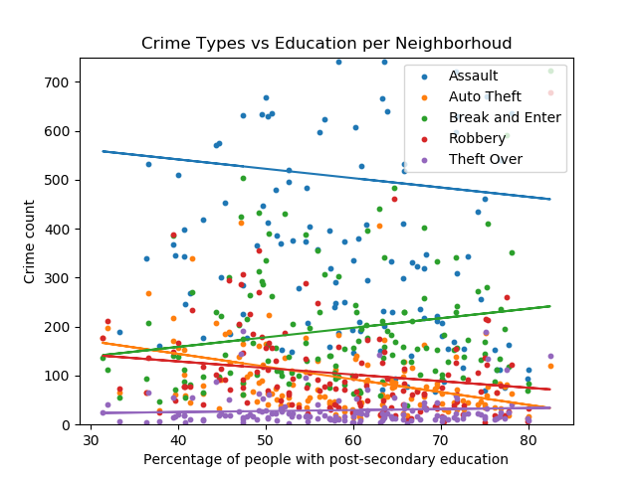
CRIMES VS INCOME AND EDUCATION

Slide 10
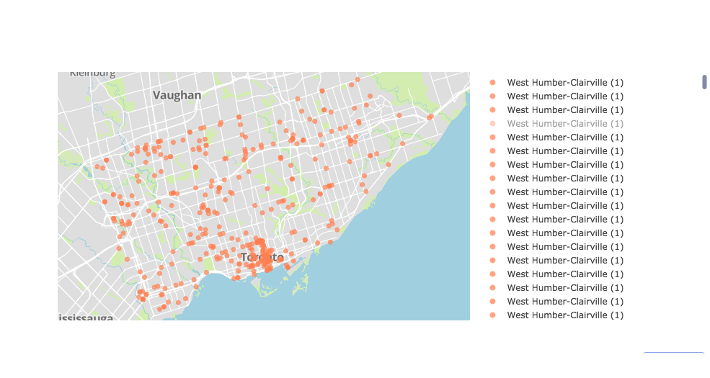
Toronto area Commercial Theft spots

Slide 11
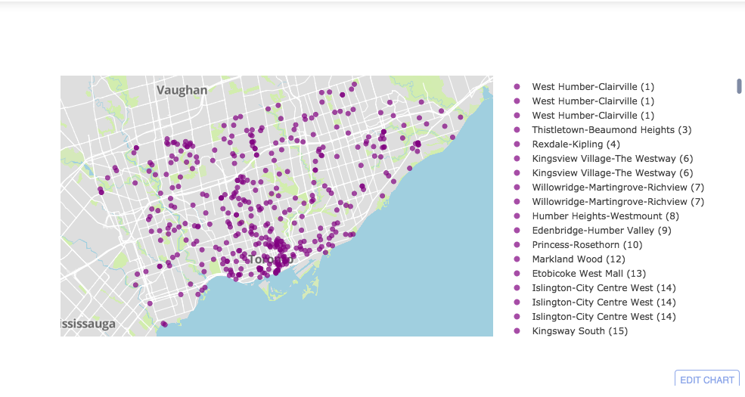
Indoor Theft

Slide 12
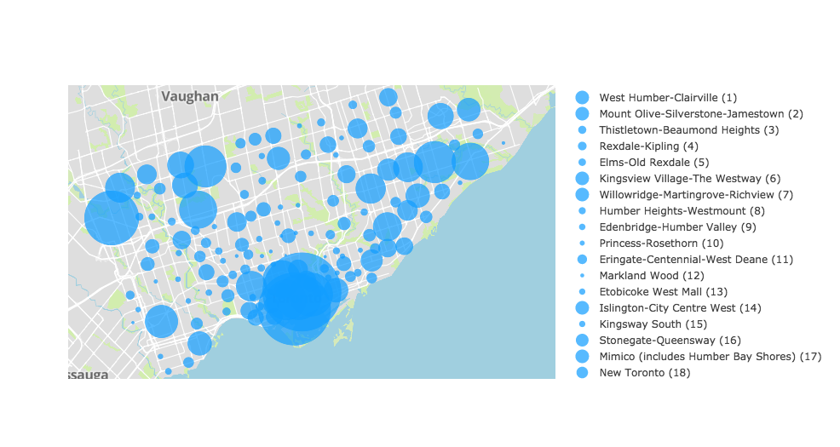
Toronto Crime hotspots

Slide 13
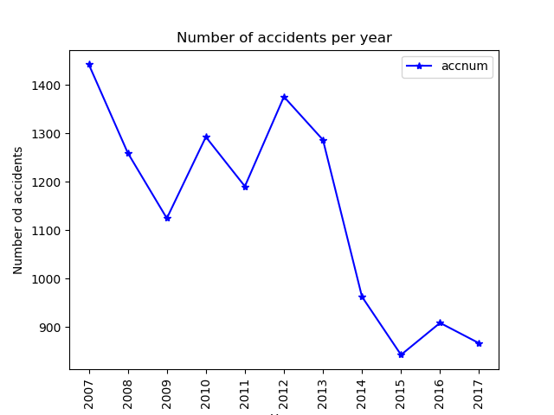
Accidents Timeline
Steep decrease in number since 2012.

Slide 14
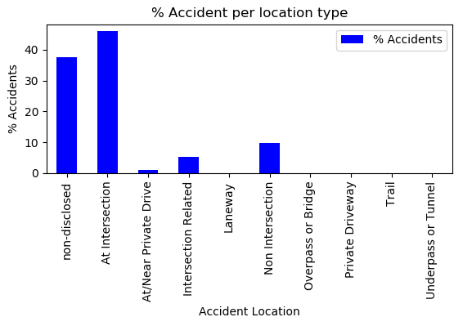
Most favorite location type for accidents
Intersection is the key

Slide 15
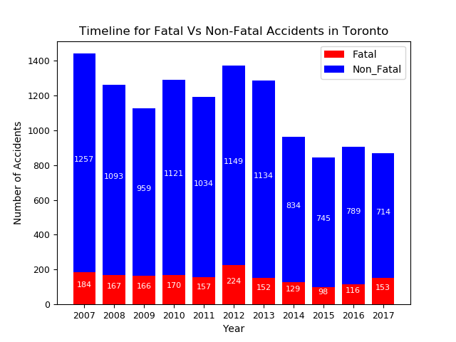
Fatal Vs Non-Fatal

Slide 16
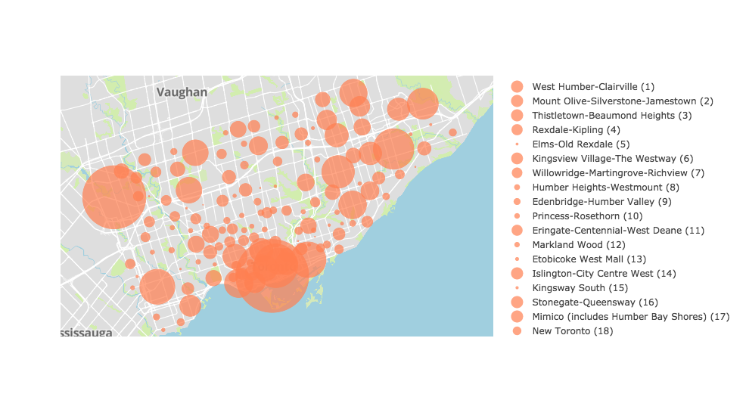
Major collision hotspot in Toronto area

Slide 17
Conclusion
Top three accident prone neighborhoods in Toronto are Waterfront communities, West Humber-Clairville and Bay street Corridor respectively.
More analysis with traffic density, and weather data can help understanding situation better.
Steep reduction in accidents was observed since 2012.
Intersections are considered the most accident prone location types in Toronto.

Slide 18
LIMITATIONS
STATS CANADA DATA IS FOR 2015 ONLY, POLICE DATA IS 2014-2017

